Slide 1
SAAA Safety Management
Introducing SERA Reporting and Data Management System

Slide 2
Aim of this presentation
Outline the purpose and component parts of a Safety Management System
Introduce key component parts that you as a member will be able to interact with
Outline the need for an effective SMS
Explain how SAAA’s SMS works
Outline SAAA documentation associated with SMS
Explain how to use SERA

Slide 3
What are the basics of a SMS?
identify safety hazards
ensure that remedial actions necessary to mitigate the risks/hazards are implemented
provide for continuous monitoring and regular assessment of the safety level achieved
clearly define lines of safety accountability, including the direct and shared responsibilities.

Slide 4
How do we achieve these goals?
ICAO has developed four component parts;
Safety Policy, Objectives and Planning;
Safety Risk Management;
Safety Assurance; and
Safety Training and Promotion.
Each part has some minor component parts, the objective is to focus on the parts that affect you and what part you can play in supporting the system.
Accepting the Safety Team will address Item 1 above in the SMS manual, let’s start with item 2.

Slide 5
Safety Risk Management;
Raising safety Occurrence Reports
Recording and processing of safety data
Passing on the results to the reporter and others
Identify the Hazard

Slide 6
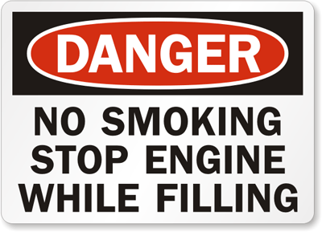
Safety Occurrence Reporting
What is an occurrence?
A hazardous situation
e.g. Smoking near a refuelling operation
A safety event
e.g. Spilt coffee during flight and burnt my leg, resulting in nearly turning inverted
Collectively referred to as an occurrence

Slide 7
Safety Reporter
Who is responsible for reporting safety occurrences?
Everyone
Events that affect you
Events that might affect others
Why is everyone responsible?
To protect everyone from injury or loss of property
Others protect you
You protect others

Slide 8
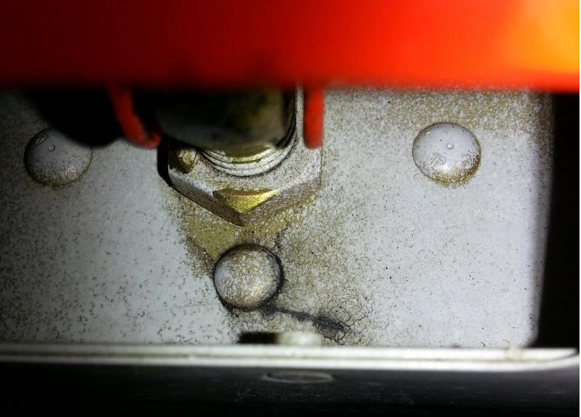
Occurrence Report
Occurrence report:
“Due to the recent loss of a RV aircraft, I decided to inspect my empennage very carefully.
I found a crack in the right elevator spar at the outboard attach point. This is how it looked upon inspection. Just a black line.
It's an RV7A with 908 hours.
Everyone please check your elevators carefully before your next flight!”
Was this relevant to other builders and owners of this type of aircraft?

Slide 9
Where was it reported?
Van’s Airforce forum
Who took notice of it?
Of the many thousands of builders, most likely only a few regularly read the forum
An Aussie builder reported the post to the SAAA Safety Manager via SERA
What was the cause of the problem?
While no formal investigation was carried out, from information gathered on line and confirmed during local inspections several options emerged
Who is responsible for informing other owners of that type of aircraft?

Slide 10
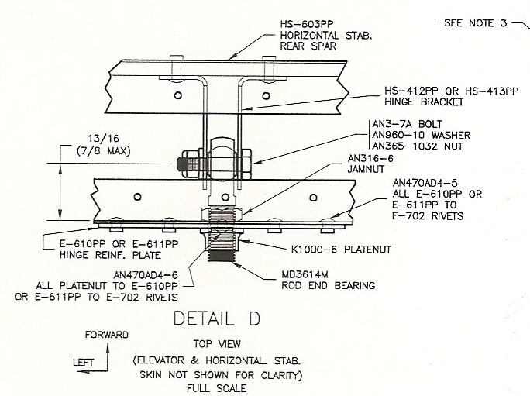
Possible causes of the problem
Possible causes include:
Hinge point misalignment?
Loose jam nut?
Residual stress from construction?
Control surface wind damage on the ground?

Slide 11
Precautionary Steps
From many posts on the Vans Airforce forum:
Ensure that the jam nuts are tight- use the correct tool to torque the nuts
Add locktite
Add marker on the nut to detect rotation (Torqueseal)
Use better system for control locks
Do we need more information?
“Sure enough, not only was one of his jam nuts finger tight on one side, the other side showed the jam nuts completely GONE! The airplane had been flying for hundreds of hours with the elevator hanging on only by a couple of #40 rivets on the nutplates.”

Slide 12
The role of Safety Management
Reporting safety Occurrence Reports
Recording and processing of safety data
Passing on the results to the reporter and others
Use our technical experts team to investigate
Everyone is responsible
Enter reports through an internet based system
Tell our members about the problem and the options for fixing it

Slide 13
Is it worth doing?
The spar crack on the RV-7 was reported on the Van’s Airforce forum in 2005.
How many RV owners know about it today?
It was reported widely in Australia in 2013 by SAAA
Are your aircraft regular inspections finding these problems?
Is it worth the effort?
Should SAAA be in the business of reporting on safety issues with our members’ aircraft?

Slide 14
Some of the SAAA’s SMS Parts in action
SERA
Reporters
Everyone
Administration
Safety Manager
Technical Experts
(TCs, APs, LAMEs)
The “Engine” of SAAA’s safety management system

Slide 15
Key SMS persons
Safety Manager
Administers the SMS
Provides training
Allocates reports to technical experts
Prepares reports
Publishes reports and analysis
Manages the SMS manual
Administers SERA
No policing duties!!!
Policing is CASA’s responsibility, not SAAA’s

Slide 16
Chapter Safety Coordinator
Chapter Safety Coordinator Role
advice on SERA
Shows members how to enter an occurrence
Shows members how to view reports
leads chapter meeting safety briefing
Discuss safety issues at the start of each chapter meeting
compiles chapter safety report to SAAA Safety Manager
Number of chapter safety events each year
Suggestions on safety from chapter members.

Slide 17
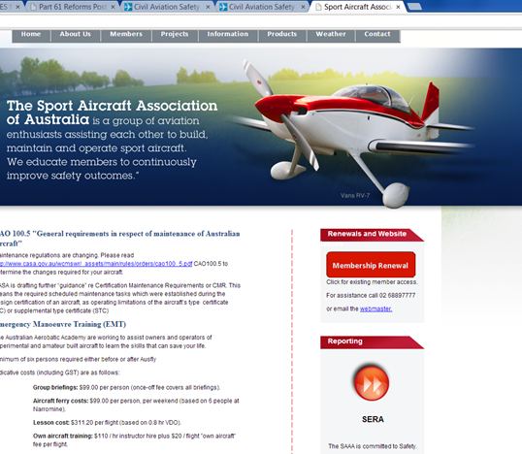
Notes on SERA
SERA is an on line reporting and safety data management system.
It is designed for managing airline safety
It is far more powerful than needed by SAAA
SAAA will use a subset of the facilities
SAAA is able to configure some of the menus to suit SAAA context
SERA is independent of SAAA, but will be accessible through the SAAA website
SAAA has its own database on SERA
The SAAA database on SERA is managed by SAAA’s Safety Manager
Enter Here

Slide 18
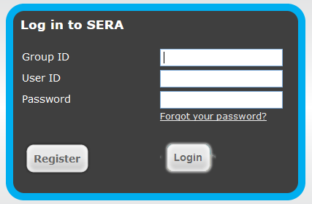
Connecting to SERA
https://www.sera.com.au
Step 1, register with SERA

Slide 19
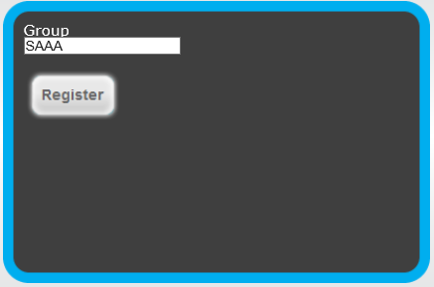
Registering with SERA
Your group ID is SAAA – type in SAAA and hit the Register button.

Slide 20
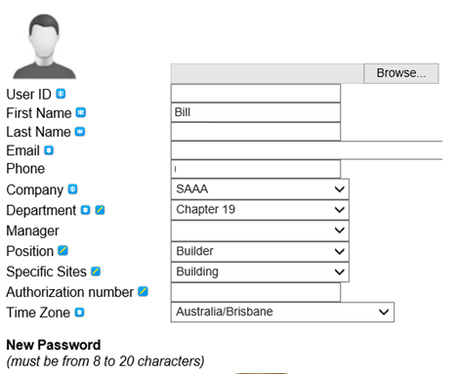
Fill out the form
Use your own User ID
Your choice ; your name or aircraft’s Rego?
Company is “SAAA”
Department is your chapter #
Other fields as required

Slide 21
Log in to SERA
Once registered, log in.
You will be logged in as a reporter
Follow the prompts

Slide 22
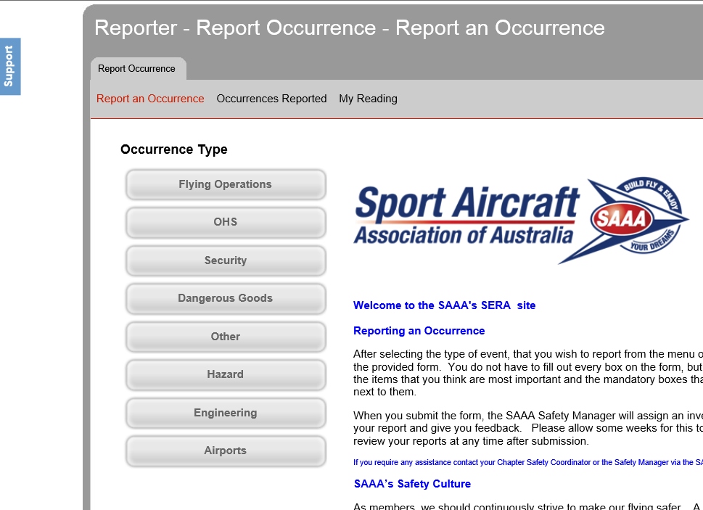
SERA Help
Help is available from the Support button

Slide 23
SERA Welcome Message
Please review the welcome message

Slide 24
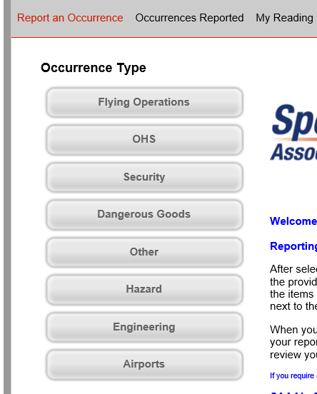
Occurrence Type
Select the most likely category for your report.
Example:
Near miss when flying through a pass in the mountains
What occurrence type would you use? Select one.

Slide 25
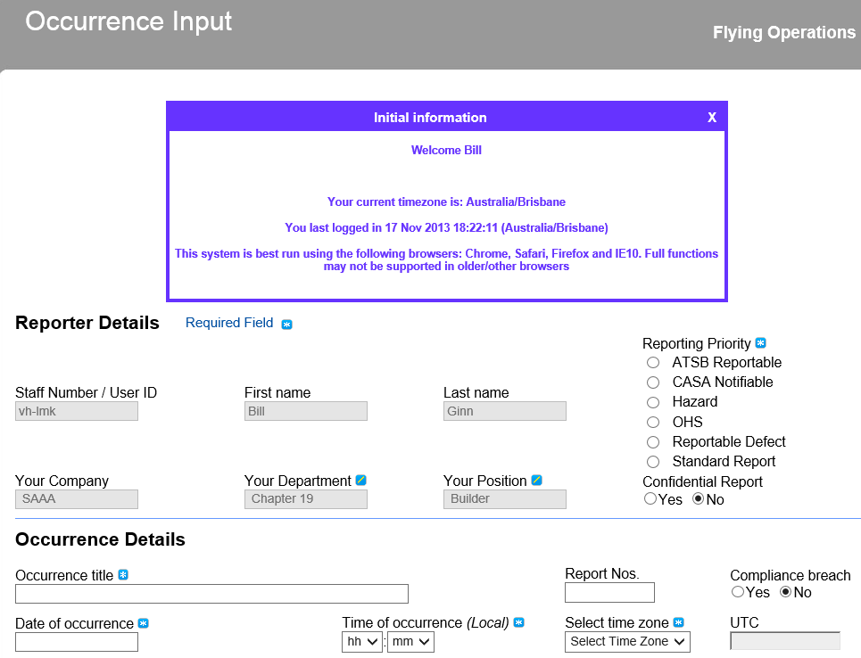
Fill in the form as best you can. Not all the fields are applicable to all occurrences, so choose the ones that are relevant.
Fields with a blue star have to be completed

Slide 26
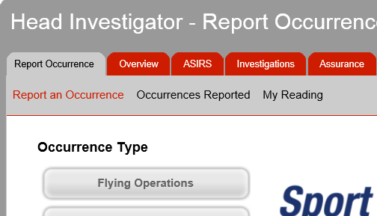
After submitting an Occurrence
SAAA’s Safety Manager will:
Review the report
Pass the report to an investigator (any volunteers?)
Monitor progress of the analysis
The reporter can:
Review submitted reports
Read comments

Slide 27
Summary
Be involved, share your experiences
Consider setting a target of say at least 1 occurrence report each year? It’s up to you, the more the better.
The more reports, the better the safety information that will be made available to everyone.
This system is ours and is not linked to CASA in any way.
All reports are kept confidential, but at the end of the day, a court order could access the data.

Slide 28
Further Information
Help with SERA access
On-line service
Chapter Safety Coordinator
SAAA Safety Manager
Discuss a safety issue
Chapter Safety Coordinator
SAAA Safety Manager

Slide 29
KEY POINTS
Key points:
A SMS is designed to collect and analyse safety data
The outcome is a safer operating environment for everyone
SAAA’s SMS uses the SERA computer database and reporting system
The Safety Manager and Chapter Safety Coordinator provide support, not policing

Slide 30
Feedback
Questions?
Contact Mike Horneman
safety@saaa.com

